Slide 1
Multi-variable covariate model comparison
Two different priors for covariate betas:
normal(0,1) and normal (0,10) [submitted paper used normal (0,10)]
Reducing included surveys to either:
Only nationally representative
Only those with GBD data at a subnational level
Note: GDI is only a national measure and would remain a national measure
 | Africa region | Americas region | East. Med. region | SEA region | Western Pacific region
National surveys | Survey=15 Country = 15 | Survey=0 Country=0 | Survey=2 Country=2 | Survey=10 Country=6 | Survey=11 Country=6
All with GBD data | Survey=29 Country = 15 | Survey=1 Country=1 | Survey=4 Country=2 | Survey=35 Country=6 | Survey=11 Country=6

Slide 2
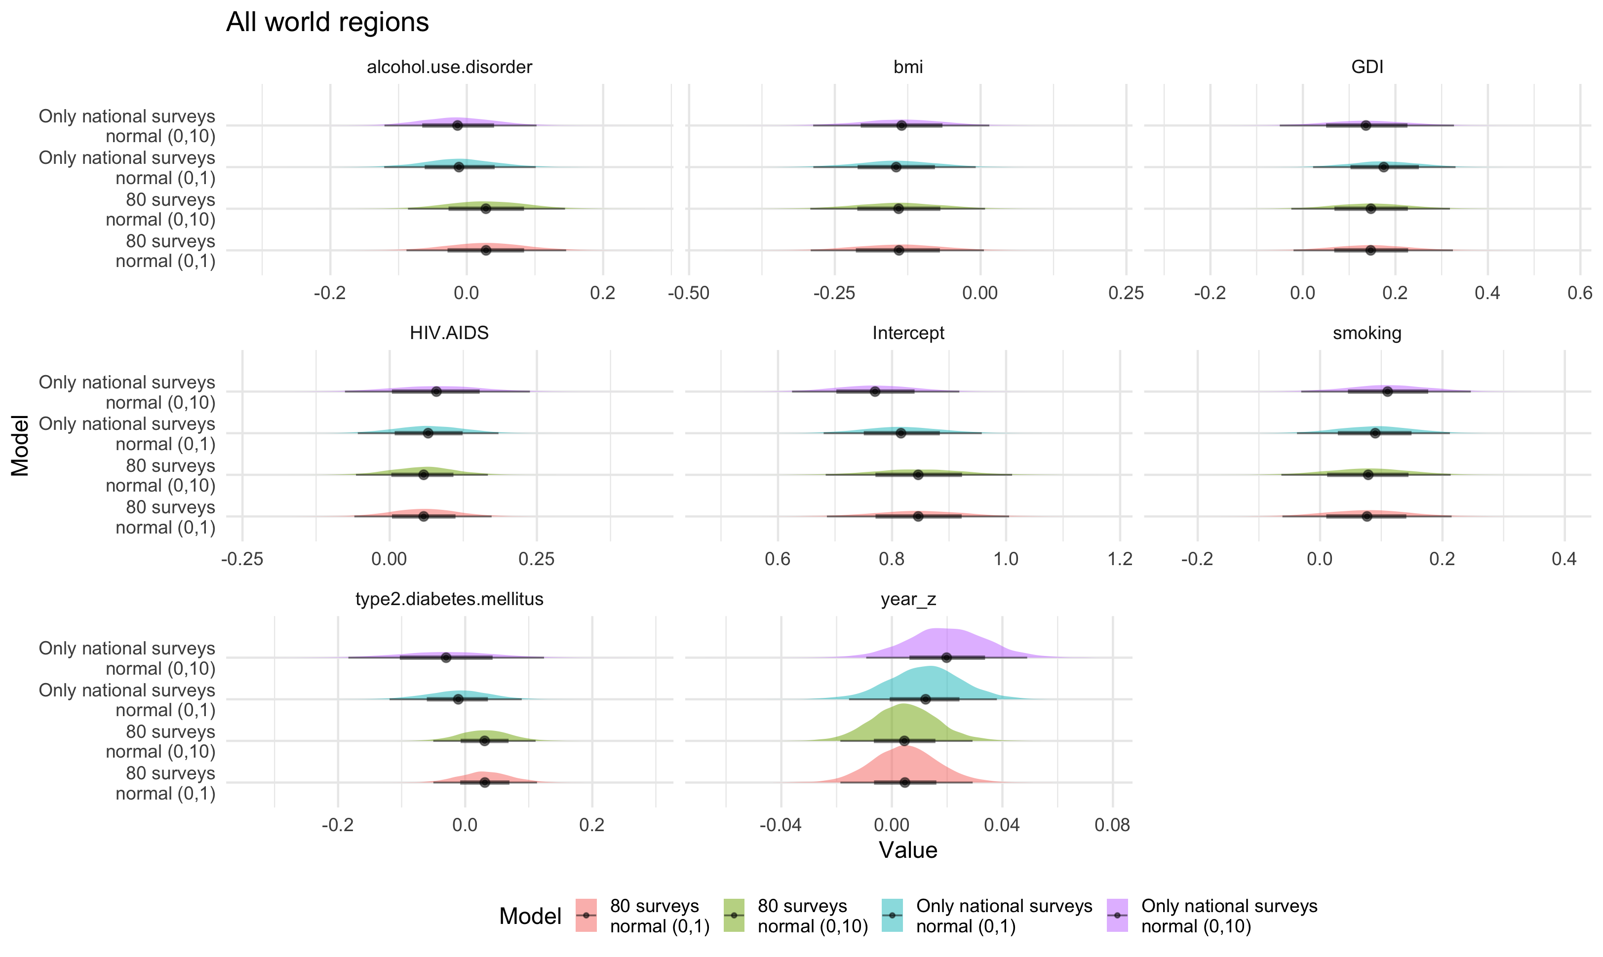

Slide 3
Parameter | Only national surveys, normal(0,10) | CrI_N10 | Only national surveys, normal(0,1) | CrI_N1 | 80 surveys, normal(0,10) | CrI_80S10 | 80 surveys, normal(0,1) | CrI_80S1
Intercept | 2.16 (1.87 , 2.50) |  | 2.26 (1.97 , 2.60) |  | 2.33 | 1.98 , 2.75 | 2.33 | 1.99 , 2.73
year_z | 1.02 (0.99 , 1.05) |  | 1.01 (0.98 , 1.04) |  | 1 | 0.98 , 1.03 | 1 | 0.98 , 1.03
GDI | 1.15 (0.95 , 1.39) |  | 1.19 (1.02 , 1.39) |  | 1.16 | 0.98 , 1.37 | 1.16 | 0.98 , 1.38
alcohol.use.disorder | 0.99 (0.89 , 1.11) |  | 0.99 (0.89 , 1.11) |  | 1.03 | 0.92 , 1.15 | 1.03 | 0.92 , 1.16
type2.diabetes.mellitus | 0.97 (0.83 , 1.13) |  | 0.99 (0.89 , 1.09) |  | 1.03 | 0.95 , 1.12 | 1.03 | 0.95 , 1.12
bmi | 0.87 (0.75 , 1.02) |  | 0.86 (0.75 , 0.99) |  | 0.87 | 0.75 , 1.01 | 0.87 | 0.75 , 1.01
HIV.AIDS | 1.08 (0.93 , 1.27) |  | 1.07 (0.95 , 1.20) |  | 1.06 | 0.94 , 1.18 | 1.06 | 0.94 , 1.19
smoking | 1.12 (0.97 , 1.28) |  | 1.09 (0.96 , 1.24) |  | 1.08 | 0.94 , 1.24 | 1.08 | 0.94 , 1.24

Slide 4
Parameter | Only national surveys, normal(0,10) | CrI | Only national surveys, normal(0,1) | CrI | Only national surveys, Cauchy(0, 1.25) | CrI
Intercept | 2.16 | 1.87 , 2.5 | 2.26 | 1.97 , 2.6 | 2.26 (1.97 , 2.6)
year_z | 1.02 | 0.99 , 1.05 | 1.01 | 0.98 , 1.04 | 1.01 (0.98 , 1.04)
GDI | 1.15 | 0.95 , 1.39 | 1.19 | 1.02 , 1.39 | 1.19 (1.02 , 1.4)
alcohol.use.disorder | 0.99 | 0.89 , 1.11 | 0.99 | 0.89 , 1.11 | 0.99 (0.89 , 1.11)
type2.diabetes.mellitus | 0.97 | 0.83 , 1.13 | 0.99 | 0.89 , 1.09 | 0.99 (0.89 , 1.10)
bmi | 0.87 | 0.75 , 1.02 | 0.86 | 0.75 , 0.99 | 0.87 (0.75 , 0.99)
HIV.AIDS | 1.08 | 0.93 , 1.27 | 1.07 | 0.95 , 1.2 | 1.07 (0.95 , 1.21)
smoking | 1.12 | 0.97 , 1.28 | 1.09 | 0.96 , 1.24 | 1.09 (0.96 , 1.24)

Slide 5
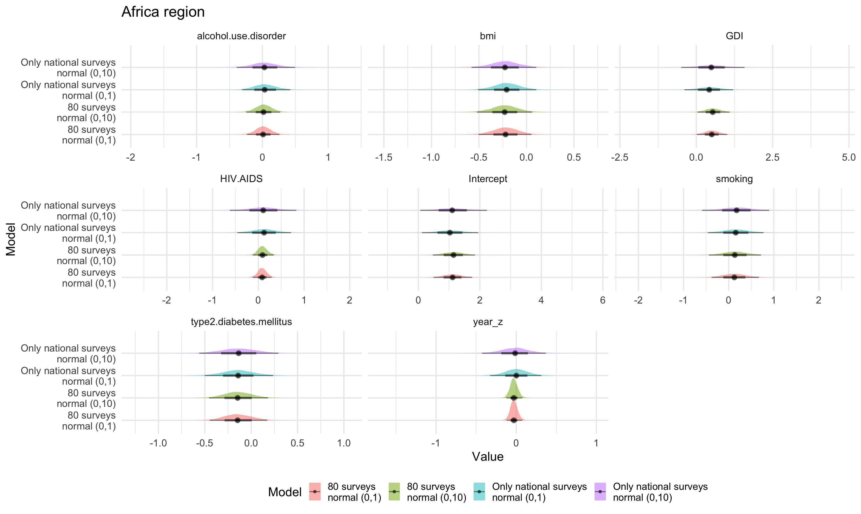

Slide 6
Parameter | Only national surveys, normal(0,10) | CrI_N10 | Only national surveys, normal(0,1) | CrI_N1 | 80 surveys, normal(0,10) | CrI_80S10 | 80 surveys, normal(0,1) | CrI_80S1
Intercept | 1.03 | 0.12-1.95 | 1.12 | 0.07-2.23 | 1.11 | 0.5-1.74 | 1.14 | 0.47-1.84
year_z | 0.00 | -0.33-0.31 | -0.02 | -0.43-0.37 | -0.03 | -0.12-0.07 | -0.03 | -0.12-0.08
GDI | 0.42 | -0.39-1.21 | 0.50 | -0.5-1.58 | 0.51 | 0.02-1.01 | 0.55 | 0.04-1.09
alcohol.use.disorder | 0.04 | -0.31-0.42 | 0.03 | -0.39-0.5 | 0.01 | -0.23-0.26 | 0.02 | -0.24-0.27
type2.diabetes.mellitus | -0.14 | -0.5-0.24 | -0.13 | -0.56-0.29 | -0.14 | -0.45-0.17 | -0.14 | -0.46-0.18
bmi | -0.21 | -0.51-0.1 | -0.23 | -0.58-0.1 | -0.22 | -0.5-0.05 | -0.23 | -0.52-0.06
HIV.AIDS | 0.12 | -0.46-0.72 | 0.11 | -0.62-0.83 | 0.09 | -0.12-0.29 | 0.10 | -0.12-0.34
smoking | 0.16 | -0.46-0.77 | 0.17 | -0.59-0.9 | 0.13 | -0.38-0.67 | 0.14 | -0.44-0.71

Slide 7
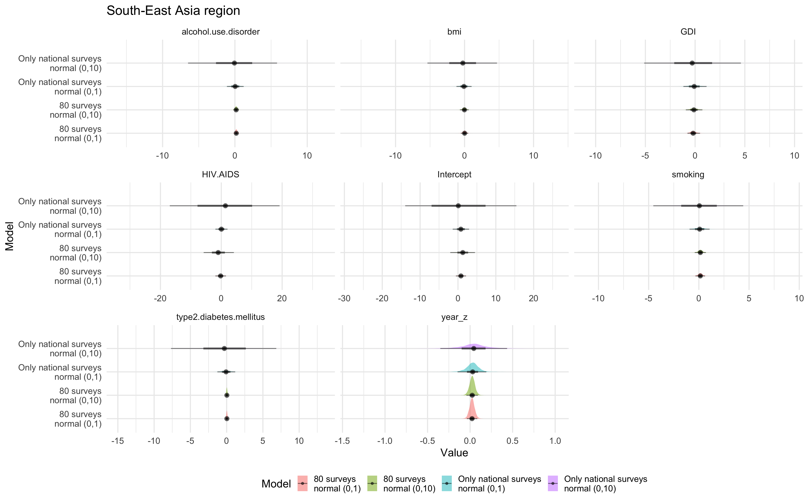

Slide 8
Parameter | Only national surveys, normal(0,10) | CrI_N10 | Only national surveys, normal(0,1) | CrI_N1 | 80 surveys, normal(0,10) | CrI_80S10 | 80 surveys, normal(0,1) | CrI_80S1
Intercept | 0.77 | -1.39-2.95 | 0.19 | -13.94-15.44 | 0.79 | -0.54-2.12 | 1.26 | -2.03-4.49
year_z | 0.03 | -0.15-0.19 | 0.04 | -0.35-0.44 | 0.02 | -0.04-0.08 | 0.02 | -0.04-0.09
GDI | -0.08 | -1.18-1.15 | -0.25 | -5.12-4.61 | -0.18 | -0.77-0.49 | -0.11 | -0.93-0.73
alcohol.use.disorder | 0.05 | -1.1-1.21 | -0.13 | -6.48-5.83 | 0.19 | -0.12-0.5 | 0.17 | -0.2-0.53
type2.diabetes.mellitus | -0.07 | -1.28-1.18 | -0.32 | -7.67-6.84 | 0.03 | -0.13-0.19 | 0.03 | -0.15-0.2
bmi | -0.09 | -1.17-1.02 | -0.28 | -5.38-4.7 | 0.00 | -0.54-0.53 | -0.03 | -0.66-0.6
HIV.AIDS | 0.04 | -1.93-2.04 | 1.22 | -16.92-19.15 | -0.21 | -1.94-1.53 | -0.96 | -5.79-4.14
smoking | 0.08 | -0.93-1.07 | 0.02 | -4.54-4.42 | 0.14 | -0.34-0.62 | 0.15 | -0.41-0.7

Slide 9
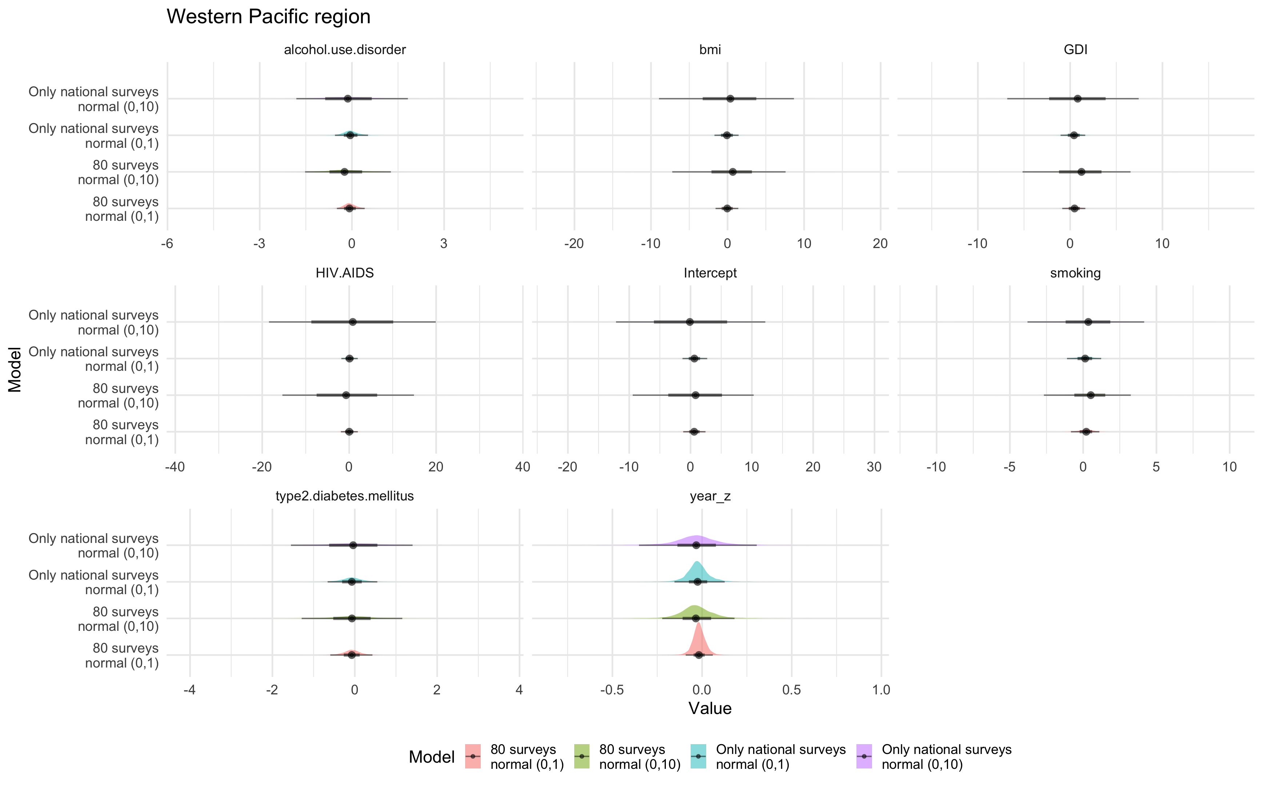

Slide 10
Parameter | Only national surveys, normal(0,10) | CrI_N10 | Only national surveys, normal(0,1) | CrI_N1 | 80 surveys, normal(0,10) | CrI_80S10 | 80 surveys, normal(0,1) | CrI_80S1
Intercept | 0.64 | -1.31-2.72 | -0.04 | -12.15-12.19 | 0.61 | -1.19-2.44 | 0.72 | -9.43-10.29
year_z | -0.02 | -0.15-0.13 | -0.03 | -0.35-0.3 | -0.02 | -0.09-0.06 | -0.03 | -0.22-0.18
GDI | 0.39 | -1.04-1.63 | 0.73 | -6.82-7.42 | 0.44 | -0.86-1.64 | 1.08 | -5.16-6.54
alcohol.use.disorder | -0.04 | -0.55-0.52 | -0.11 | -1.81-1.82 | -0.07 | -0.49-0.41 | -0.20 | -1.52-1.27
type2.diabetes.mellitus | -0.07 | -0.66-0.55 | -0.04 | -1.55-1.4 | -0.07 | -0.59-0.43 | -0.07 | -1.29-1.15
bmi | -0.09 | -1.71-1.44 | 0.26 | -8.95-8.68 | -0.06 | -1.57-1.4 | 0.56 | -7.22-7.58
HIV.AIDS | 0.08 | -1.81-1.97 | 0.76 | -18.45-19.91 | 0.03 | -1.91-1.98 | -0.55 | -15.36-14.89
smoking | 0.12 | -1.1-1.23 | 0.30 | -3.8-4.17 | 0.19 | -0.83-1.11 | 0.46 | -2.68-3.25

Slide 11
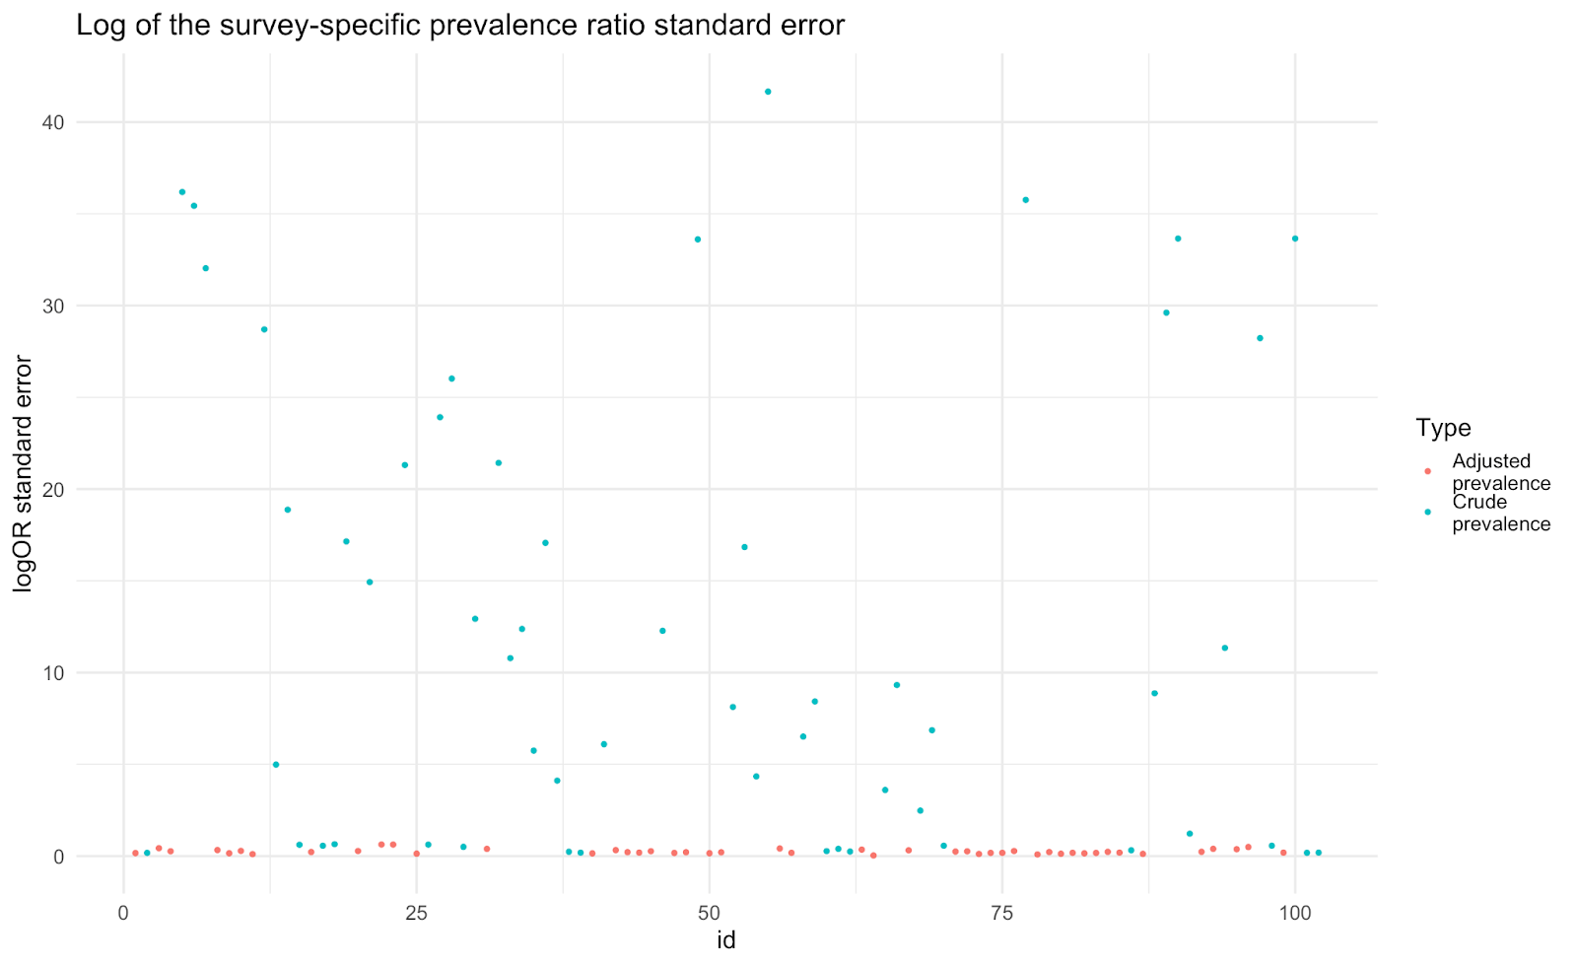

Slide 13
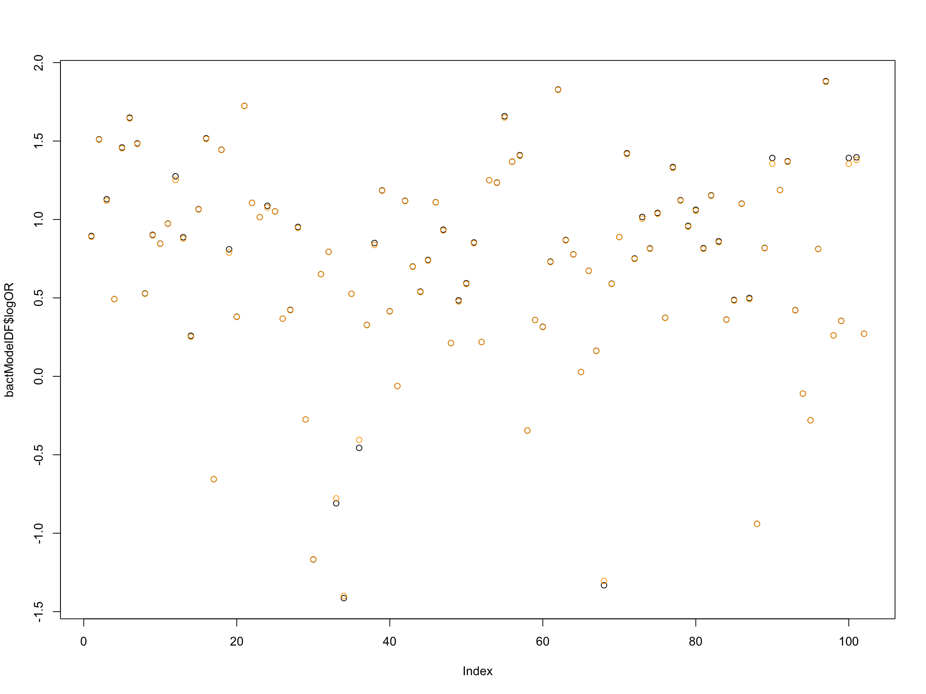
Log(OR) [black] and log(PR) [orange]

Slide 14
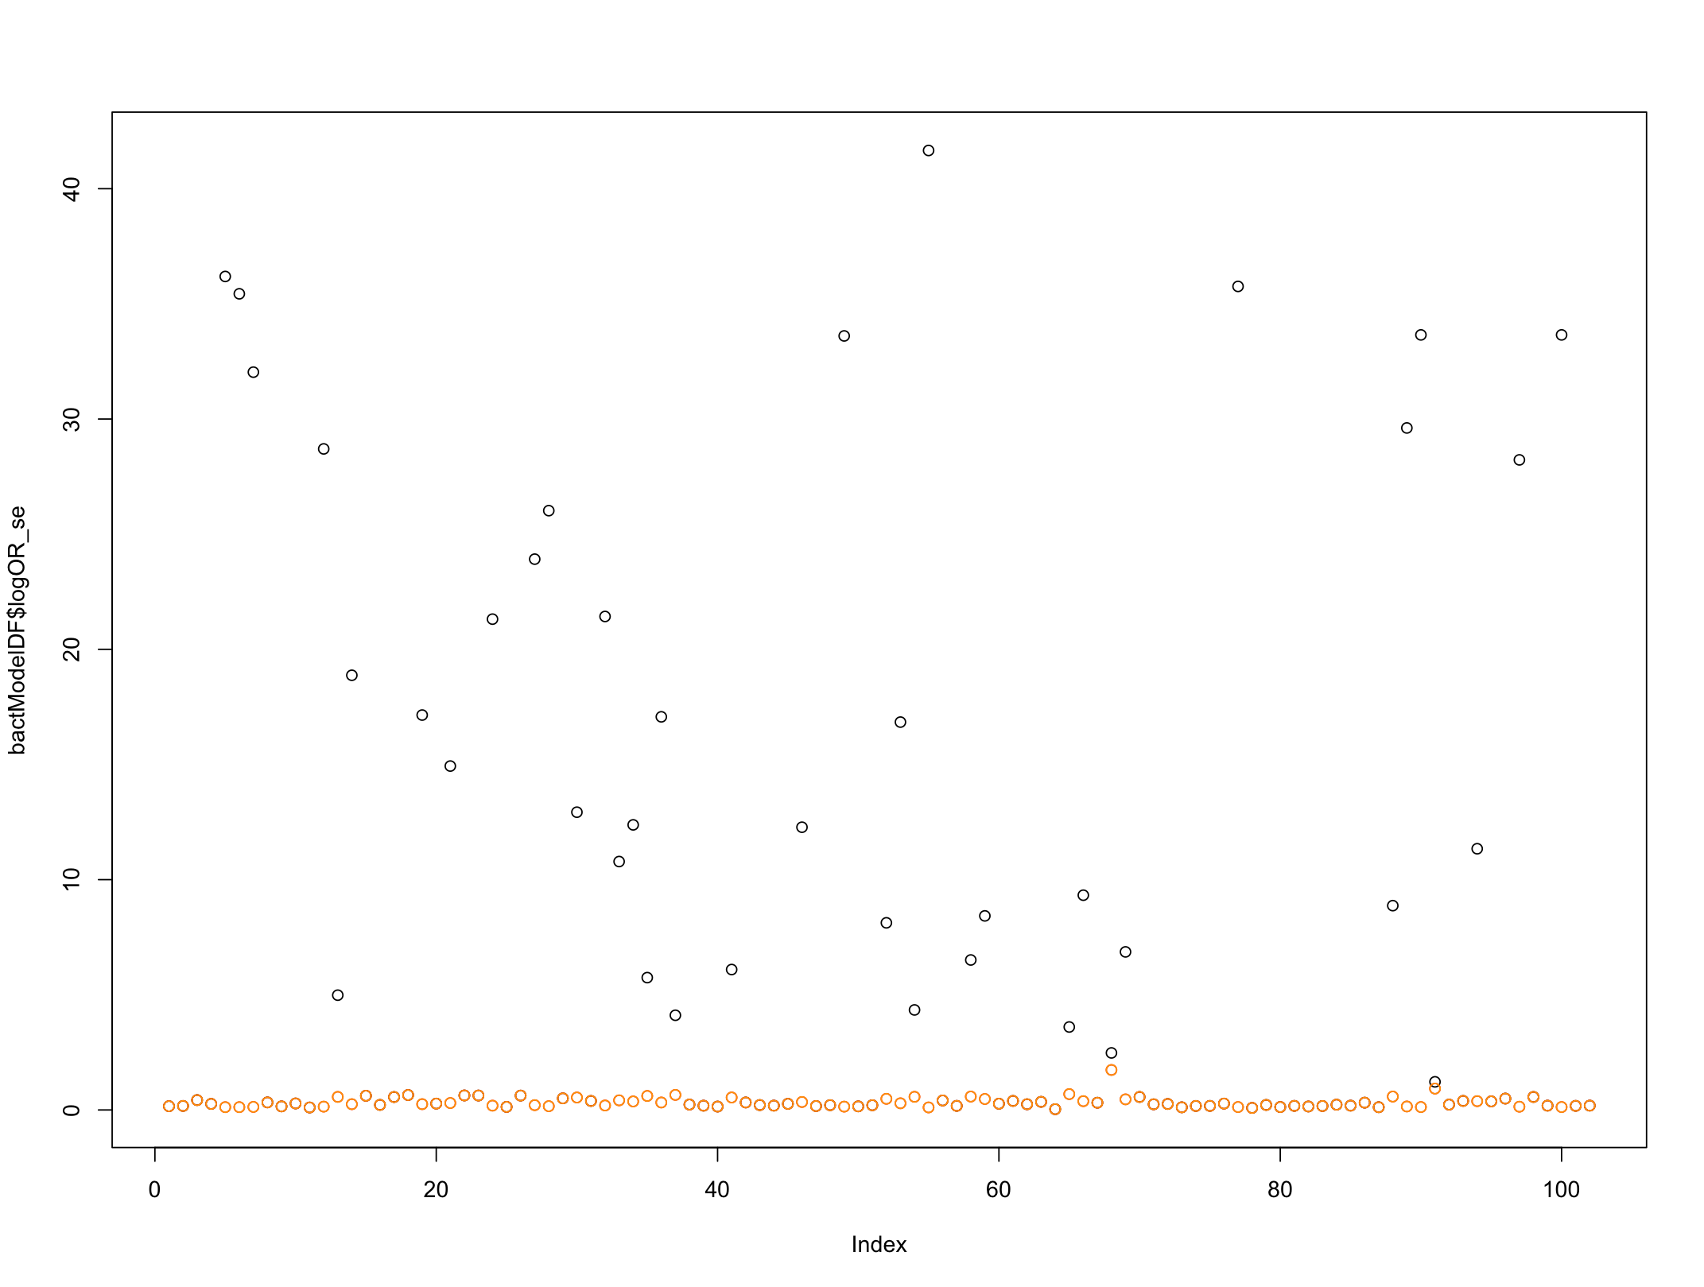
Log(OR)_se [black] and log(PR)_se [orange]

Slide 15
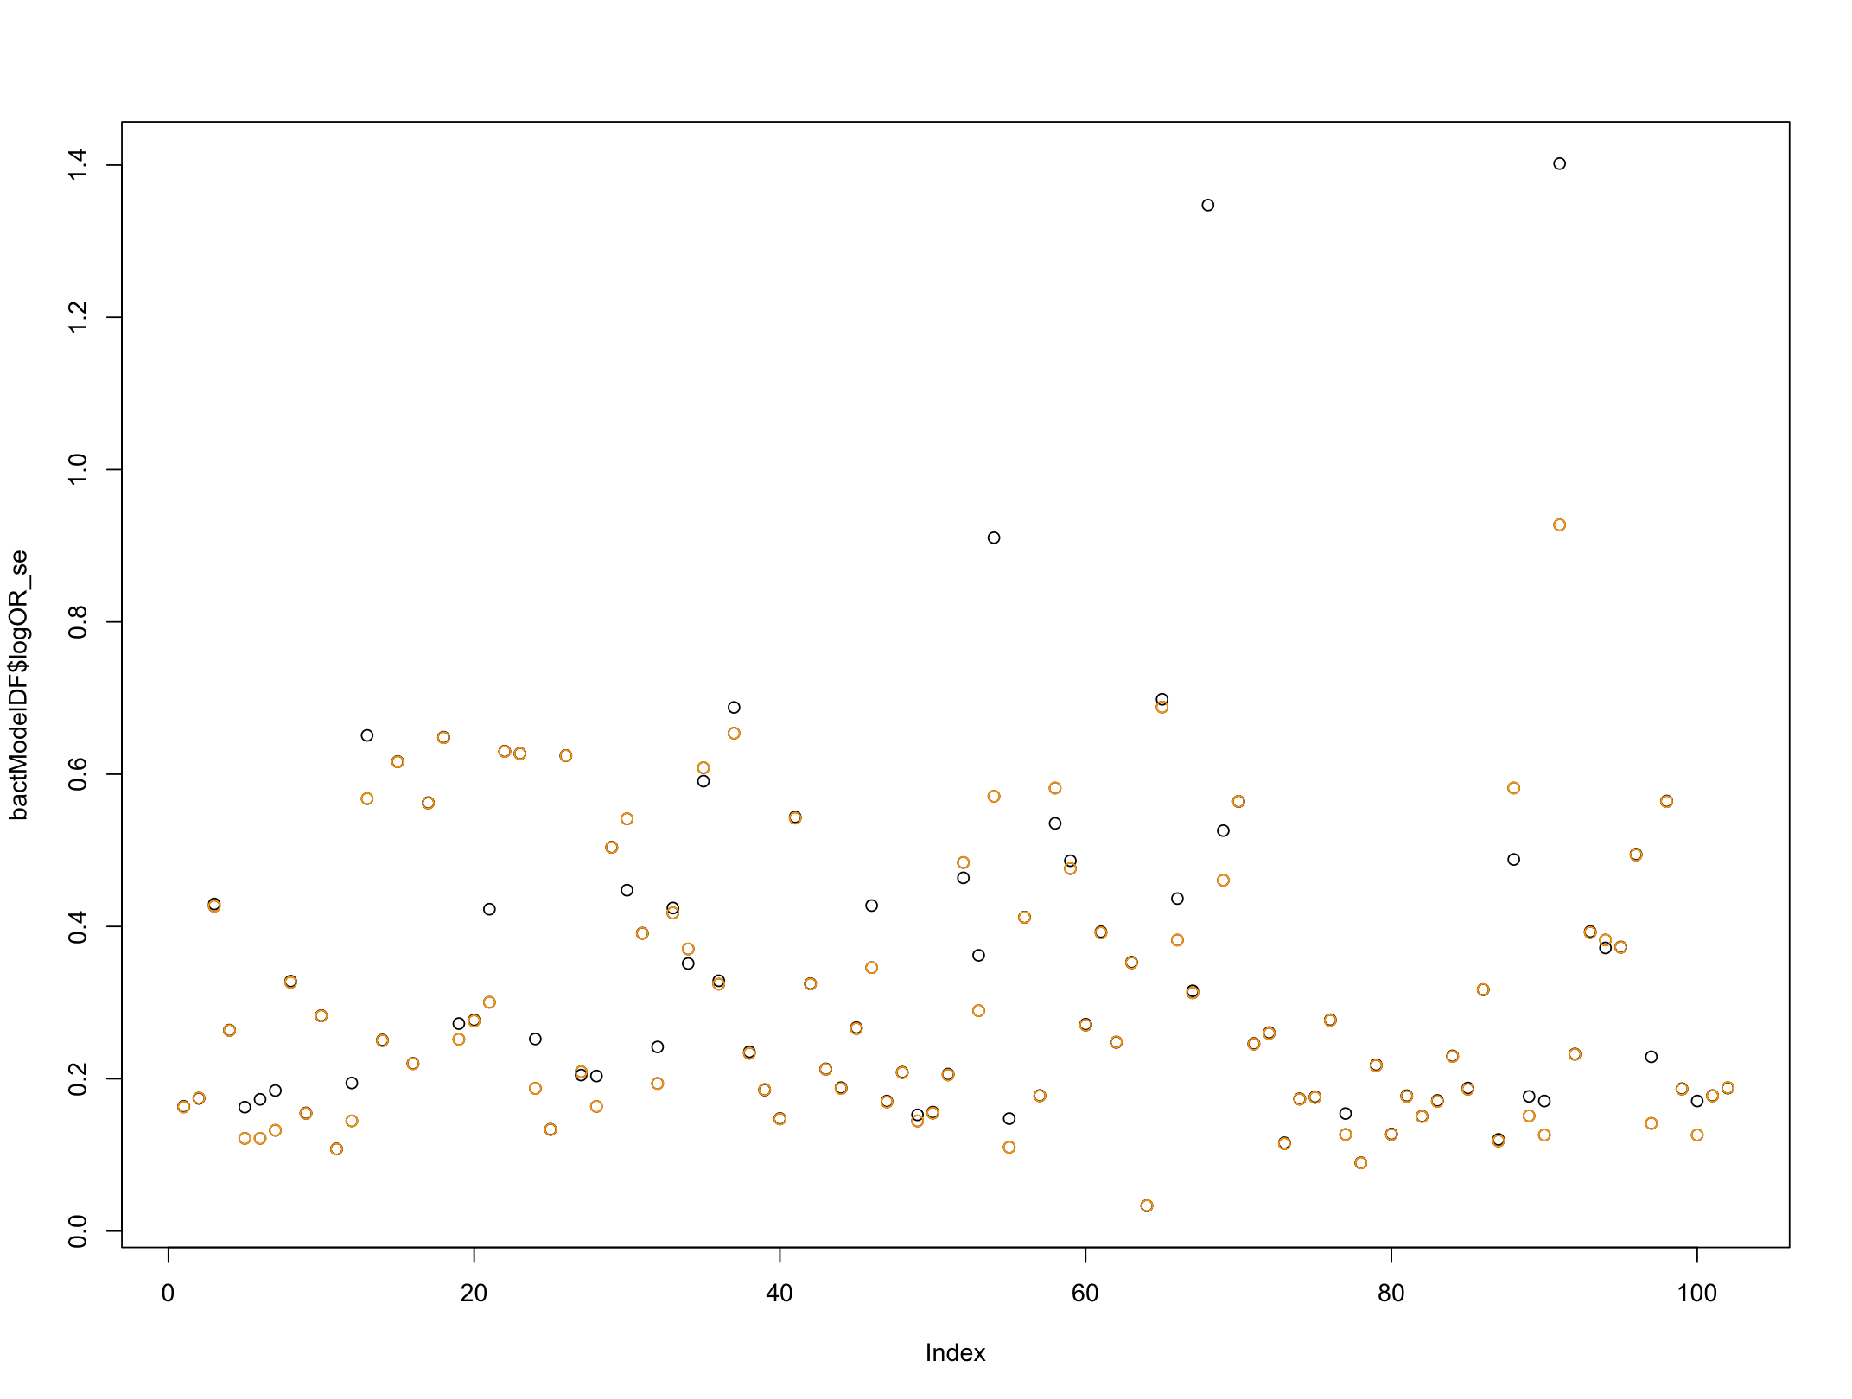
Log(OR)_se [black] and log(PR)_se [orange]

Slide 16
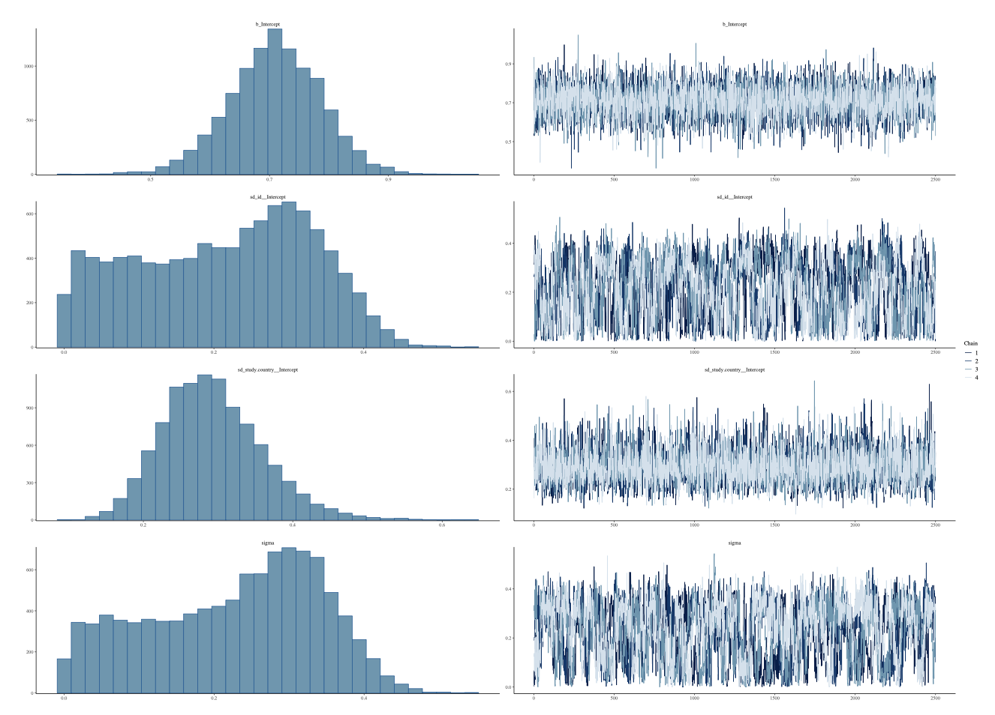
M:F ratio main estimate
Previously reported 2.23
Using updated log(OR)_se 2.02 (1.72-2.36)
Using log(PR) 2.04 (1.74-2.36)

Slide 17
Low ESS for model hyperparameter sd(Intercept) ~ ID
And residual variance parameter, sigma
prior of exponential(1) gives best ESS, but have tried quite a few half-normal(0,1)
half-normal(0,5) half-t(4,0,1)…

Slide 18
M:F ratio by world region
WHO region | new | Old
Africa (N_{BC}=38; N_{SP}=22) | 1.58 (1.36-1.81) | 1.84 (1.61–2.10)
Americas (N_{BC}=2; N_{SP}=2) | 1.13 (0.49-2.06) | 2.36 (0.79–5.21)
Eastern Mediterranean (N_{BC}=4; N_{SP}=3) | 1.66 (1.04-2.49) | 1.76 (1.17–2.49)
South-East Asia (N_{BC}=40; N_{SP}=24) | 3.20 (2.79-3.64) | 2.91 (2.51–3.33)
Western Pacific (N_{BC}=18; N_{SP}=13) | 2.42 (1.99-2.90) | 2.57 (2.16–3.02)

